Slide 1



City of Laguna Niguel
Community Outreach Meeting – Public Hearing #2
September 19, 2023

Slide 2

Agenda
Things we will cover:
  What is Districting/Redistricting
  Required Districting/Redistricting Criteria
  Laguna Niguel Census Data
  How you can give public testimony
  Public Hearing Schedule

Slide 3
What is Districting
Definition
Districting is the initial process of creating election district boundaries.
These boundaries determine:
  Eligibility to run for office – must live within boundaries to qualify for election.
  Who votes in the election – only voters within the district vote for their city councilmember.

Slide 4
What is Districting
Definition
Districting is the initial process of creating election district boundaries.
These boundaries do not determine:
  How the City decides to govern. The City can still work to achieve goals that benefit the district as a whole rather than the interests of any single district.
  How services or relationships between the City and the public are managed.

Slide 5
Required Redistricting Criteria
Traditional redistricting principles used throughout the country and written into state law
There are a number of criteria that are required under the FAIR MAPS Act (ranked):
  Relatively equal size - people, not citizens, all ages
  Contiguous – districts should not hop/jump
  Maintain “communities of interest”
  Easily identifiable and understandable lines,
  following natural and man-made boundaries
  Keep districts compact – appearance/function

Slide 6
Equal Population
Utilizing the US Census Decennial File
What is “equal” population has been a key subject in districting litigation.
Population Equality is based on “People” not citizens or voters or other metrics.
10% deviation presumed equal. Other agencies / states have different plan deviation requirements.

Slide 7

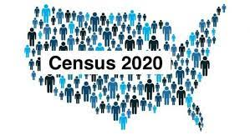
Datasets
Data you will see throughout this process
All federal Census Data used in this districting comes from the Statewide Database (SWDB), which is directly used for all redistrictings throughout the State of California.
Citizen Voting Age Population (CVAP) is used to comply with the Voting Rights Act and comes from the American Community Survey, originating from the US Census Bureau and retrieved from the SWDB.
Voter data in line drawing is not used, and any use of partisanship is prohibited.

Slide 8
Required Redistricting Criteria
Traditional redistricting principles used throughout the country and written into state law
There are a number of criteria that are required under the FAIR MAPS Act (ranked):
  Relatively equal size - people, not citizens
  Contiguous – districts should not hop/jump
  Maintain “communities of interest”
  Easily identifiable and understandable lines,
  following natural and man-made boundaries
  Keep districts compact – appearance/function

Slide 9
Contiguity
Two definitions for what is contiguous
Contiguity should be thought of as “literal” and “functional.”
An area that is one whole
piece is “literally contiguous.”
An area that represents
how the population functions
or how people are connected
is “functionally contiguous.”

Slide 10
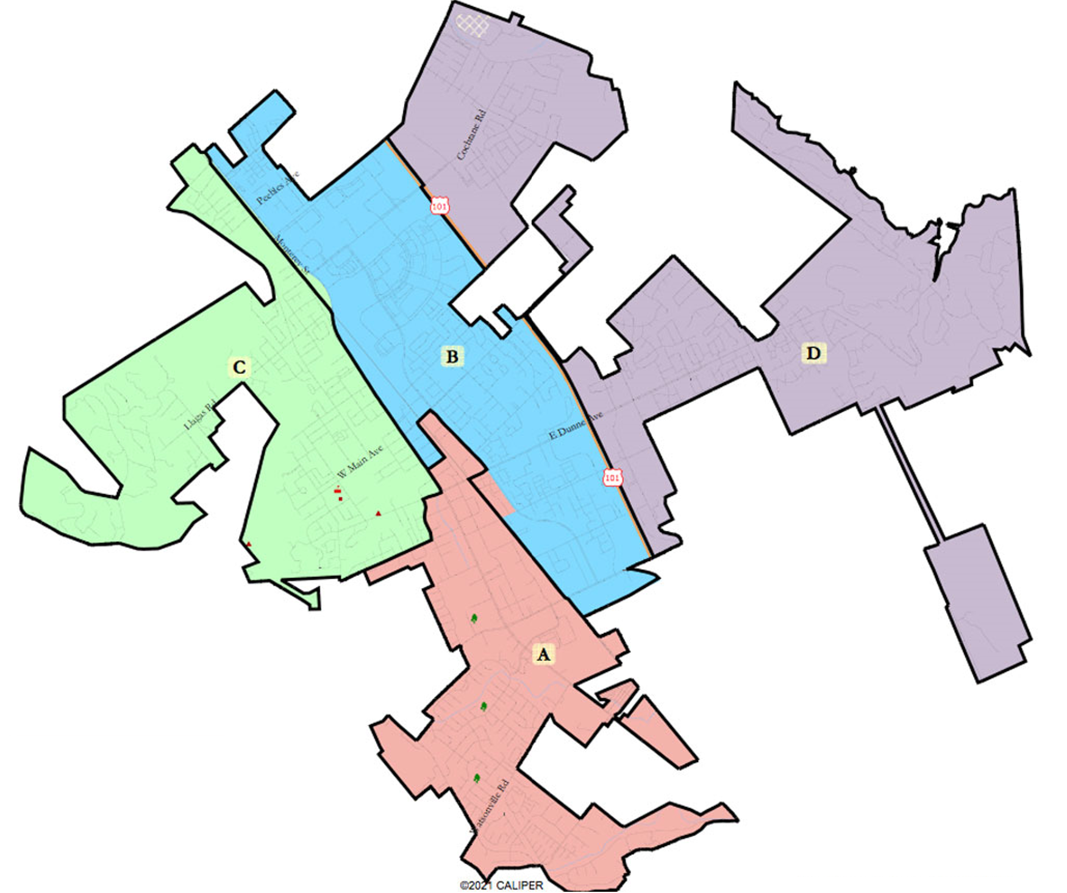
Contiguity
Determining what is “contiguous”

Slide 11
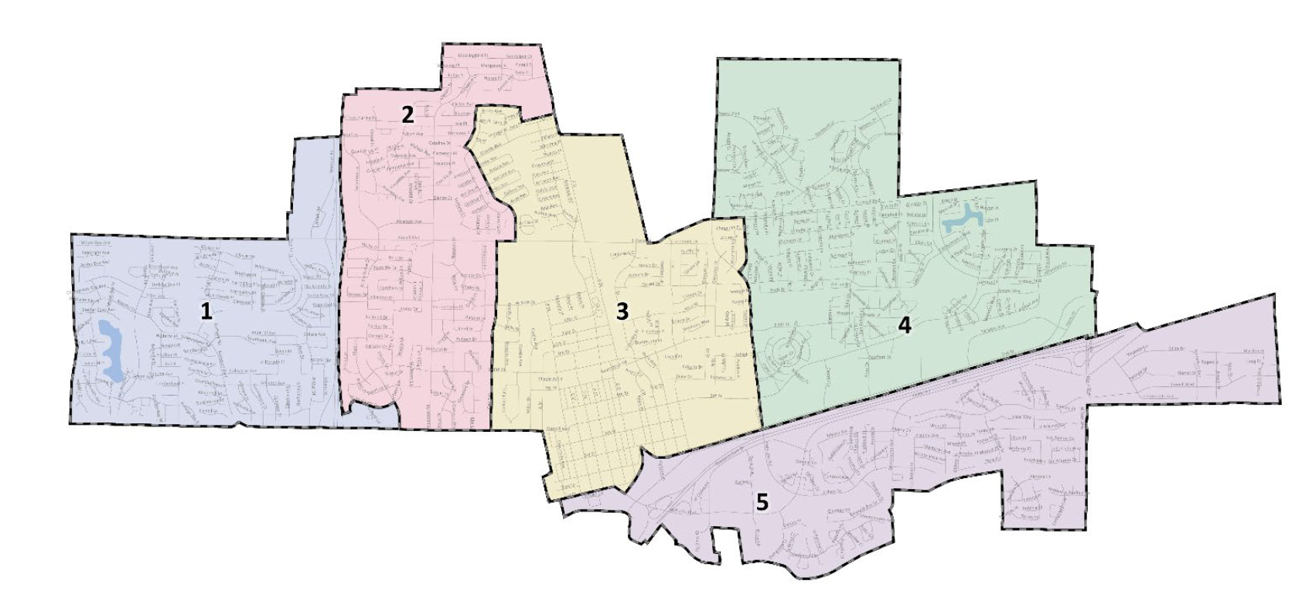

Contiguity
Determining what is “contiguity”
Railroad tracks act as a barrier, physically separating the city with only three thoroughfares between District 5 and the rest of the city.

Slide 12
Required Redistricting Criteria
Traditional redistricting principles used throughout the country and written into state law
There are a number of criteria that are required under the FAIR MAPS Act (ranked):
  Relatively equal size - people, not citizens
  Contiguous – districts should not hop/jump
  Maintain “communities of interest”
  Easily identifiable and understandable lines,
  following natural and man-made boundaries
  Keep districts compact – appearance/function

Slide 13
Communities of Interest
Bringing like people together for representation
Communities of interest are the building blocks of election-districts.
A community of interest includes ethnic and language minorities and other groups.
      Subjective
      Open-ended to be as inclusive as possible
Examples of Voting Rights Act Communities
      Latinos
      Asians
      African Americans
Notes:
Clarify your goals
What issues do you and your neighbors care about?
What level(s) of government impact those issues?
Are you advocating for a community of interest or a whole map plan?
How does influencing the maps help your cause?
Does being Subjective also mean that you don’t need Census data?

Slide 14
Communities of Interest
Bringing like people together for representation
Communities of interest are the building blocks of election-districts.
A community of interest includes ethnic and language minorities and other groups.
      Subjective
      Open-ended to be as inclusive as possible
Examples of Voting Rights Act Communities
      Latinos
      Asians
      African Americans
While communities of interest may include race, it cannot be the predominant factor in drawing district boundaries.
Notes:
Clarify your goals
What issues do you and your neighbors care about?
What level(s) of government impact those issues?
Are you advocating for a community of interest or a whole map plan?
How does influencing the maps help your cause?

Slide 15
Communities of Interest
Bringing like people together for representation
Historical communities
Economic interests
Racial composition
Ethnic Areas
Cultural amenities
Religious facilities
Immigrant communities
Languages spoken
Geographic features
Neighborhoods/ HOAs
Economic opportunity zones
Tourism Areas
School districts
Outdoor recreation areas
Communities defined by natural resource features
Downtown / Urban
Rural or Agricultural
Homeowner or Renters
Creative arts communities
Media markets
Many, many more
Notes:
These are just a few examples of how you can start thinking about your COI. If you can make the argument that your community is a community of interest, it likely is one.

Slide 16
What is NOT a Community of Interest
Preventing a Districting from becoming a Gerrymander
The Fair Maps Act explicitly prohibits these groups from being considered as communities of interest
  Political party affiliation
  Incumbents
  Political candidates
It also is hard, in redistricting to truly utilize:
  Groups of similarly minded people who do not share a similar geographic location or are citywide.
Notes:
Go through basics of each of them
Note – the final bullet is not illegal under FMA, but it impossible to draw such a COI
We’re trying to help protect communities of interest when we draw maps, and if a COI is 80 percent of a city, then that doesn’t really help the map drawers.

Slide 17
Communities of Interest
Three Critical Questions in Defining YOUR Community
    Does the community have a shared culture, characteristics or bond?
    Is the community geographic in nature? Is the community able to be mapped?
    Describe the community’s relationship with the jurisdiction and how it is affected by the policy decisions made by the elected officials.
Notes:
Some people have a hard time thinking through COI so lets go through an example
Add gerrymander game in, bring in Redistricting 101 presentation, LB
Culture:
Personal Stories are powerful. Find community members willing to share examples if things residents share in common and what makes your community unique. Imagine describing your community to someone who wants to move to your community.
Does your neighborhodo share certain celebrations or traditions?
Are there important places where your community gathers?
What is the history of how your community came together?
Concerns:
Often communiteis get involved in redistricting because they feel their issue have not been adequately addressed by their elected representative. Highlighting community issues in personal stories and written narratives help demonstrate the importance of having elected officials who understand and respond to community needs.
Has your community come together to advocate for important services?
Have you worked for more recognition or support of your community?
Counts
Whenever possible include statistics to support your testimonies, including data on education levels, graduation rates, median household income, poverty levels, access to technology, homeownership rates, language isolation, voter registration rates etc.
This information can be gathered from the U.S. Census Bureau, universities, local government reports etc
Consider using reliable sources as the Census Bureau to find data on income , education, language, race, ethnicity and ancestry.

Slide 18
Required Redistricting Criteria
Traditional redistricting principles used throughout the country and written into state law
There are a number of criteria that are required under the FAIR MAPS Act (ranked):
  Relatively equal size - people, not citizens
  Contiguous – districts should not hop/jump
  Maintain “communities of interest”
  Easily identifiable and understandable lines,
  following natural and man-made boundaries
  Keep districts compact – appearance/function

Slide 19
Required Redistricting Criteria
Traditional redistricting principles used throughout the country and written into state law
There are a number of criteria that are required under the FAIR MAPS Act (ranked):
  Relatively equal size - people, not citizens
  Contiguous – districts should not hop/jump
  Maintain “communities of interest”
  Easily identifiable and understandable lines,
  following natural and man-made boundaries
  Keep districts compact – appearance/function

Slide 20
Compactness
Determining what is “compact”
The measure of compactness can get complicated.
Ratio of the circumference of
a district and the area of a district.
Measuring the number of distinct straight lines and the number of kinks and bends.
Simply outlawing funny shapes.

Slide 21
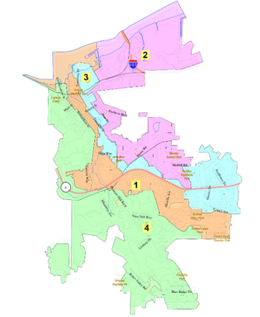
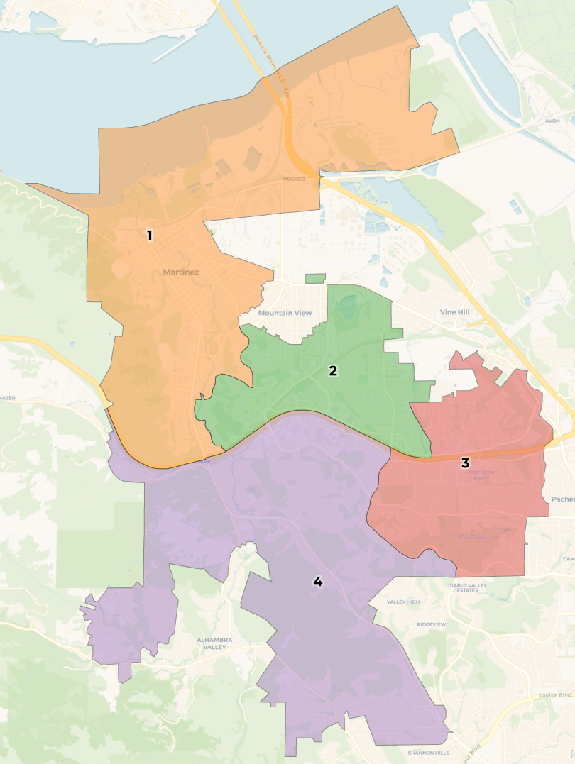
Compactness
Determining what is “compact”

Slide 22
Map Submissions
The public plays a critical role in districting through map submissions:
Two types of public map input:
Community of Interest Maps
District Plans Based on 2020 Census Data
All maps will be reviewed by the City Councilmembers for consideration and documented as public testimony.

Slide 23

Map Submissions
Drawing YOUR Communities of Interest
The City of Laguna Niguel is using ‘Districtr’ as a public mapping tool to allow residents to draw their own Communities of Interest.
https://districtr.org/tag/laguna_niguel
Notes:
Online tool that is very user friendly.
Create COIs, name and describe them, save them – will appear on the City of Martinez’s DistrictR page, where you will be able to see other community members’ maps as well

Slide 24
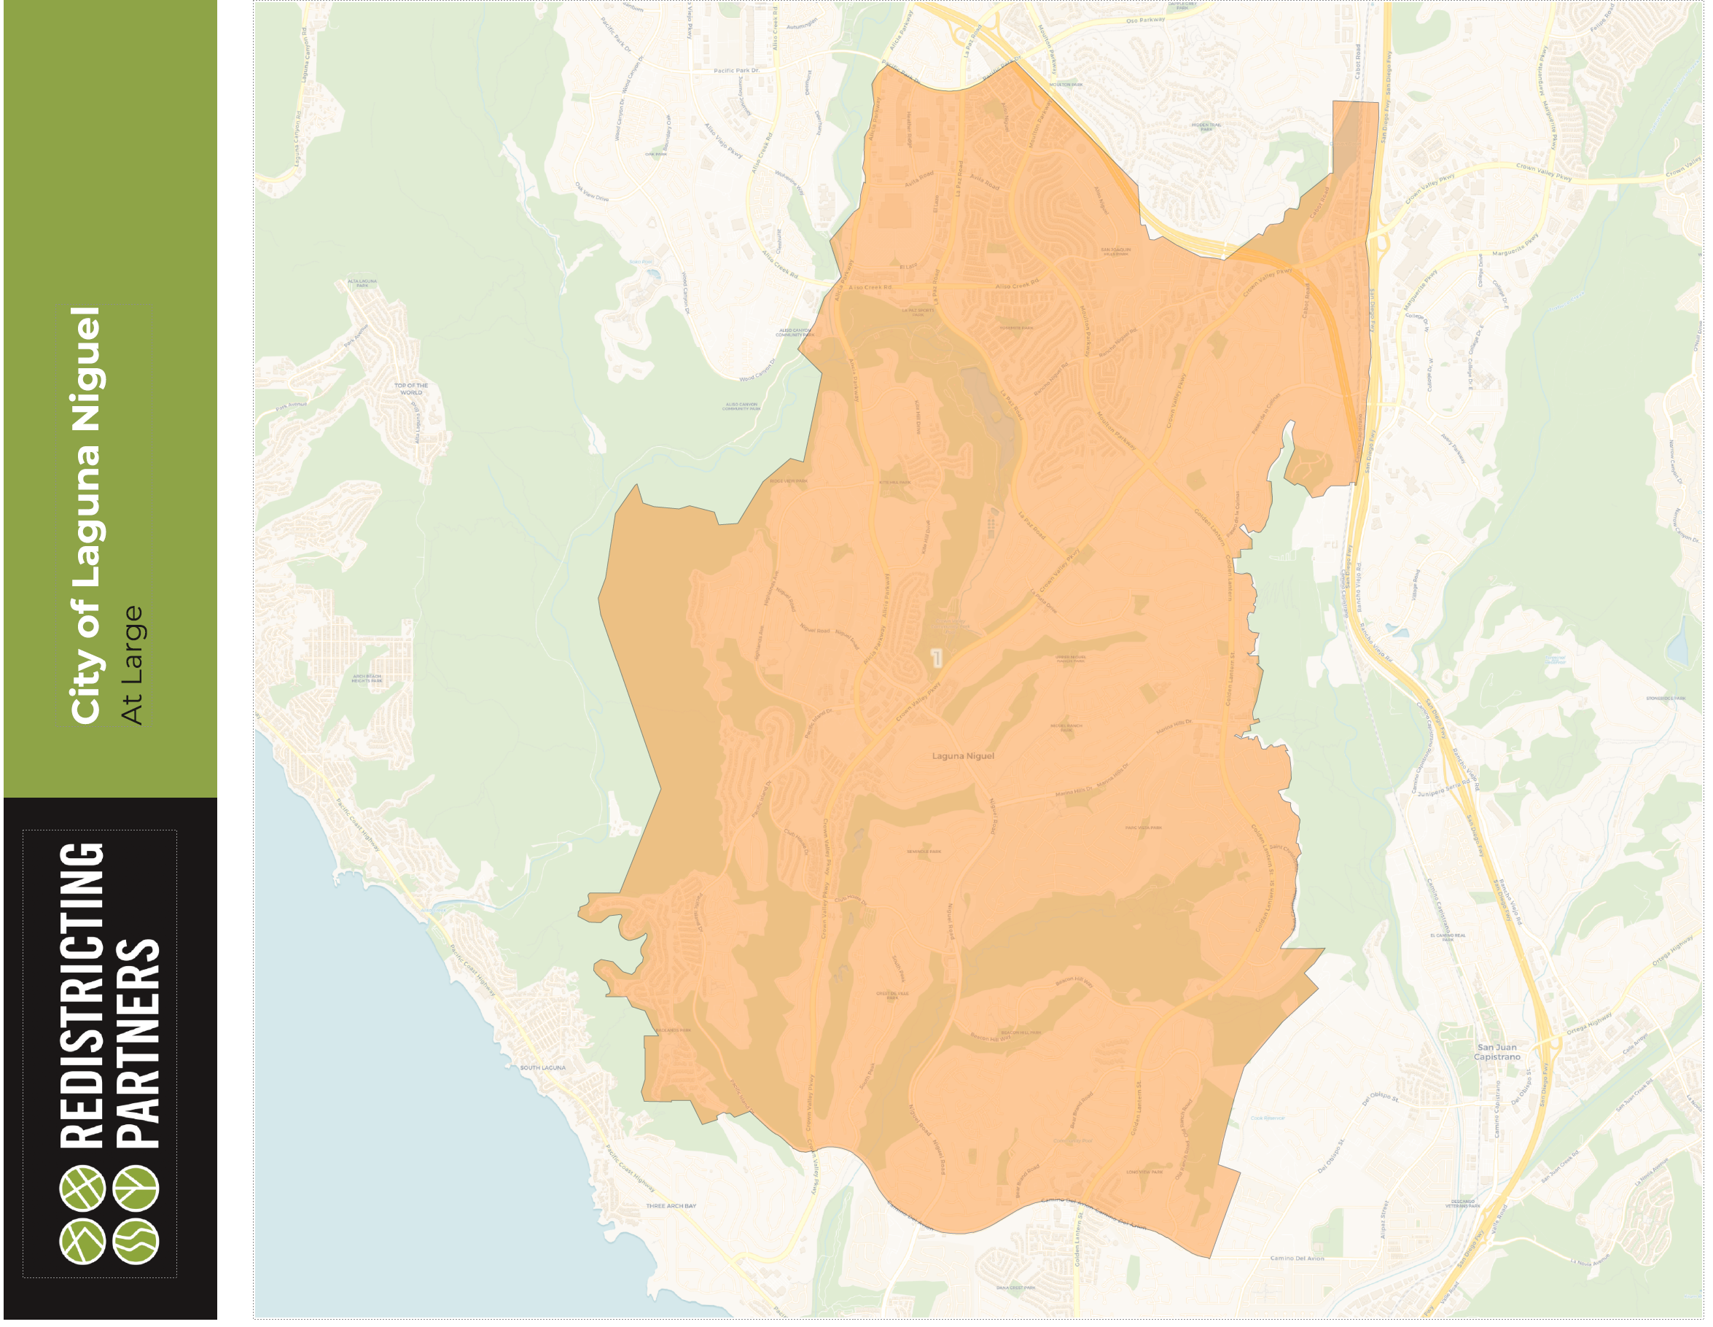

Slide 25
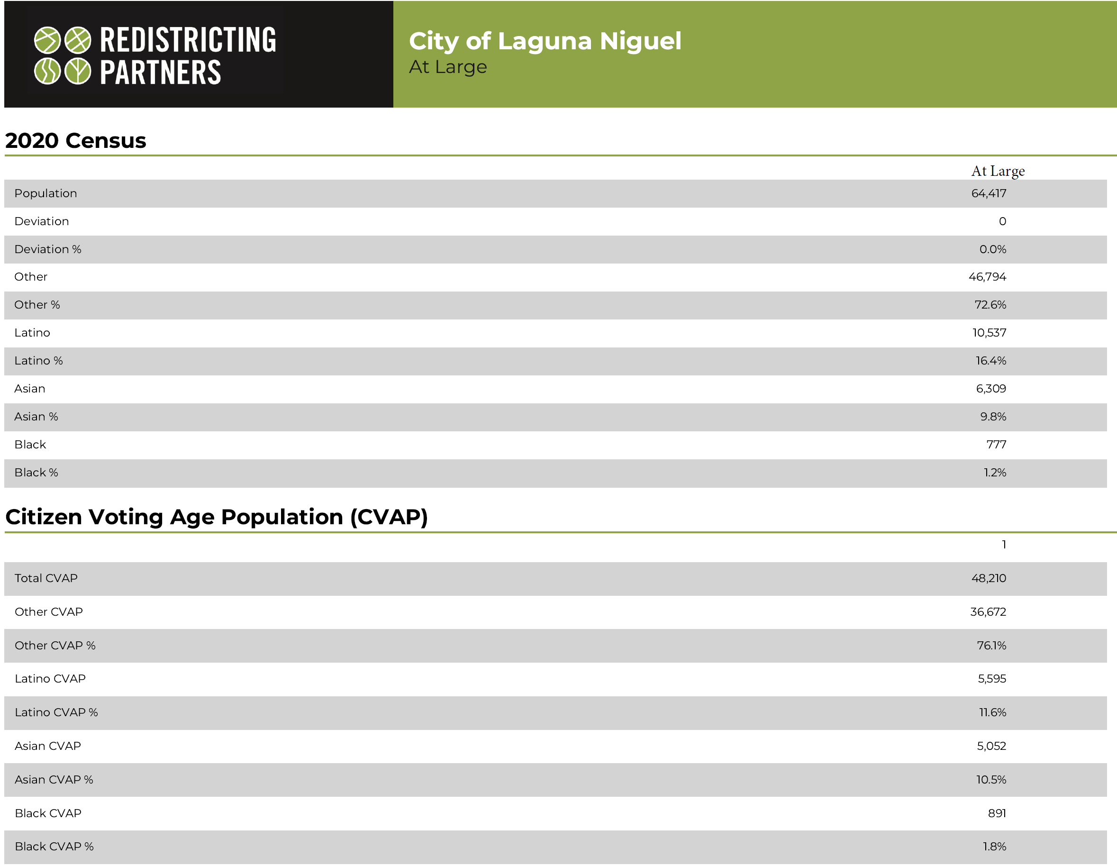

Slide 26
City of Laguna Niguel
Districting Timeline
Proposed Schedule:
  September 5, 2023 Public Hearing #1 (Pre-map)
  September 19, 2023 Public Hearing #2 (Pre-map)
  November 7, 2023 Public Hearing #3: Introduce Draft Maps
  December 5, 2023 Public Hearing #4: Revised Draft Maps
  January 2024 Public Hearing #5: Final Vote/Adoption
Notes:
Or the last meeting can be October 3, 2023

Slide 27
Next Steps
The City Council is the decision-making authority throughout this entire process, and Redistricting Partners will draft maps based on public testimony and direction from the City Council.
Tonight, the City Council will:
Receive and review public testimony.
Provide demographer with input related to communities of interest.
Direct demographers to create draft maps based upon city council input and FAIR MAPS Act ranked criteria.
November 7 Public Hearing #3:
City Council to review publicly submitted maps.
Demographer will provide 3 draft maps based on the City Council’s direction.
Continue to hear public testimony.
City Council will provide feedback and further direction on changes to the draft maps, while narrowing down their preferred map(s).
Notes:
If directed, we can create maps based off of HOAs, or use certain roads as a divider. We can also be directed to only uplift public maps as the official three draft maps.

